Slide 1
Theme 4: The Constitution of 1996: Basic Principles, Concepts and Doctrines

Slide 2
Recap
Notes:
Kleyn et all 169
We will go into some of these in more details in theme 4

Slide 3
The Application of the Bill of Rights
When litigating the Bill of Rights, the Court has to determine whether the BOR applies
Directly or Indirectly
Vertically or Horizontally
Notes:
Ordinary rules of law (Legislation, common law, customary law)

Slide 4
What did we celebrate on Monday?
What is its significance?
How does it encapsulate what we have done this semester?

Slide 5
Democracy!
What do you think is Democracy?
How do we define democracy?
Notes:
One of the dominate and enduring political ideas of modern times
In the South African Constitution, the idea of democracy is a prominent one permeates virtually all aspects of the constitution

Slide 6
Democracy!
We have a “Constitutional Democracy”
Pre-amble” ‘ A Society based on democratic values’
S1(d): elections and a multi-party system of democratic government, to ensure accountability, responsiveness and openness

Slide 7
Democracy!
Undeniably one of the dominate and enduring political ideas of modern times
A CORE concept and value of the 1996 Constitution
In the 1996 Constitution, the idea of democracy is so prominent it permeates virtually all aspects of the Constitution

Slide 8
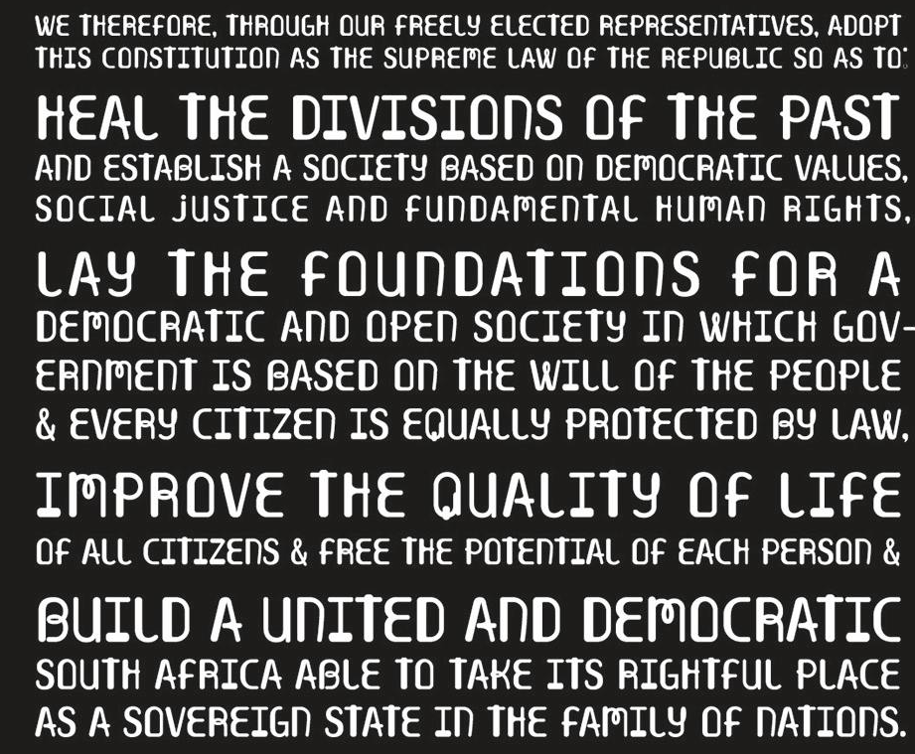

Slide 10
Democracy!
S1 ushers in democracy by declaring South Africa to be “a sovereign, democratic state”.
S1(d) Democratic values: “universal adult suffrage, a national common voters' roll, regular elections and a multi-party system of democratic government, to ensure accountability, responsiveness and openness.
Notes:
S1 does not define what democracy means in SA, but shows us the elements that are paramount in the South African Constitutional Context

Slide 11
How to define Democracy in the 1996 Constitution Context
Democracy – as a concept – defies singular definition
However, we can still get an understanding of what democracy entails.
Theuys Roux : ‘The core idea – that decisions affecting the members of a political community should be taken by the members themselves, or at least by elected representatives whose power to make those decisions ultimately derives from the members – is more or less settled’
Notes:
There is not one idea of democracy, but different conceptions of democracy

Slide 12
How to define Democracy…
Roux’s idea of democracy is linked to the notion that people should prevail and have a say in how they are governed.
However, it is not possible to have every individual vote on every decision, so this conceptualisation of democracy highlights that modern democracy is exercised through institutionalised politics that entails electing individuals or organisations to represent their interests
Roux’s definition also lends itself to understanding that democracy, as found in the 1996 constitution, embodies different conceptions of democracy
Notes:
There is not one idea of democracy, but different conceptions of democracy

Slide 13
Types of Democracy
Direct Democracy
Representative democracy
Participatory democracy
Constitutional Democracy

Slide 14
Direct democracy
Decisions affecting the members of a political community should be taken by the members themselves = direct democracy
Historically considered the purest form of democracy.
What are some elements of direct democracy in the Constitution?

Slide 15
Direct democracy
Section 17: Right to assemble, demonstrate, picket and present petitions, unarmed and peacefully
Section 84(2)(g): President can call a national referendum
Section 127(2)(f) Provincial premier can call a provincial referendum
Does SA have a substantive form of direct democracy?
\ Look at discussion of Merafong city decision (De vos s2.5.3)
Notes:
S17 allows citizens to make there views known, influence decisions affecting them unhindered – highlights that despite the prominate of representative governance – citizens must ALWAYS have a say in the decisions that affect them
S84/ 127 – to date we have not used this mechansism in SA

Slide 16
Representative Democracy
Most decisions are not made by direct involvement by the citizenry
Decisions affecting the members of a political community are made by elected representatives whose power to make those decisions ultimately derives from the members = representative democracy
Citizens elect representatives to govern for a limited time

Slide 17
Representative Democracy
Section 42(3) :“The National Assembly is elected to represent the people and to ensure government by the people
Section 19(3)(a): Every adult citizen has the right to vote in elections
Role of political parties - our democracy is founded on a multi-party system of government (S1(d))
Link between citizens and political parties/representatives

Slide 18
Representative Democracy
Multi-party government:
A system where three or more political parties have the capacity to gain control of the government, either separately or through a coalition
S19 read with s1(d) = MPG Is an integral part of our democracy
It is characterised by competitive elections, proportional representation, and usually a coalition of political parties working together to form a majority in the legislation

Slide 19
Representative Democracy
But in New Nation Movement v President of RSA 2020 CC
CC found the Electoral Act unconstitutional as it violated citizens' political rights (Section 19) by allowing only political parties to contest national and provincial elections, invalidating the exclusion of independent candidates.
This decision necessitated fundamental electoral reform in South Africa, moving towards a system that allows for individual candidacy rather than exclusively party-based representation.
Electoral Amendment Bill – signed 20 April 2023
Notes:
n New Nation Movement NPC and Others v President of the Republic of South Africa and Others [2020] ZACC 11, the Constitutional Court of South Africa ruled on 11 June 2020 that the Electoral Act 73 of 1998 is unconstitutional. It violated citizens' political rights (Section 19 of the Constitution) by allowing only political parties to contest national and provincial elections, invalidating the exclusion of independent candidates

Slide 20
Representative Democracy
Electoral Amendment Act 1 of 2023
Allows independent candidates (not afflicated to political parties) to contest elections for the National Assembly and provincial legislatures for the first time
Came into effect for 2024 elections
Independent candidates must prove support to qualify. Candidates need to have 1,000 signatures in support of them.
Notes:
To be nominated as a IC
Be a South African citizen, at least 18 years old, and registered to vote in the province where they intend to contest.
Submit a prescribed nomination form and pay an election deposit.
Sign a declaration to be bound by the Electoral Code of Conduct.
Not be disqualified under the Constitution (e.g., due to a prison sentence exceeding 12 months without the option of a fine)

Slide 21
Representative Democracy
2024 elections = No Party got Majority – GNU government
Democratic implications of the GNU
Power sharing: inclusive governance through multi-party collaboration
Checks and Balances: No single majority ensures more balanced policy-making
Challenges: tensions over ideological differences ( VAT, NHI, foreign policy)
Notes:
Following the 29 May 2024 general elections, South Africa entered a new political era with the formation of a Government of National Unity (GNU). This became necessary after the African National Congress (ANC) failed to secure an outright majority for the first time since 1994, receiving 40.18% of the national vote.
The GNU is a multi-party coalition comprising 10 political parties that collectively represent approximately 72% of the seats in the National Assembly. The participating parties signed a Statement of Intent to cooperate in both the Executive and the Legislature.

Slide 22
Limitations of Representative Democracy
Representative democracy is the only workable system…
Failure to regulate political parties, elite-driven democracy
Inability to directly influence elected members in between elections
Influence of those not actively involved in political parties
Has Electoral Amendment Act fixed this?
One-party dominance
Affected democratic accountability and limited democratic participation, eroding separation between political parties and the state
Notes:
Failure to regulate political parties – the fact that there is no requirement that political parties practise some form of internal democracy ultimately has the effect of conferring a huge amount of power on leadership who may dominate party affairs and impose their preferred representatives
The fact that the citizenry cannot really effect/influence directly their representatives outside of the election cycle – leaves the electorate in the position of onlookers as elected representatives take decisions in the name of the electorate without an opportunity to oppose independently unpopular decisoons
If not involved in a political party – next to impossible to infleucne decisions that affect them – lack of opportunities to cpntirnute their views effectively
Previously, one party dominate democracy – effects democratic accountability -

Slide 23
Participatory Democracy
Tries to counteract the political exclusion of citizens' opinions in decision-making
Participatory democracy = affording citizens an opportunity to have their voice heard when decisions are made that affect them
Section 1(d) “system of democratic government to ensure accountability, responsiveness and openness”
Section 59(1)(a)and 72(1)(a), and 118: NA and NCOP MUST facilitate public participation in law-making processes

Slide 24
Participatory Democracy
Doctors for Life v Speaker of the National Assembly para 105-117
South Africa has both representative and participatory democracy
Which are are mutually supportive
The participation by the public on a continuous basis provides vitality to the functioning of representative democracy
The court invalidated legislation in circumstances where there had not been sufficient opportunity for public participation on legislation that significancy affects the lives of people
Notes:
The landmark case of Doctors for Life International v Speaker of the National Assembly (2006) established that public participation is a mandatory "requirement of manner and form" in South Africa's law-making process. The Constitutional Court ruled that if Parliament fails to take reasonable steps to facilitate public involvement, the resulting legislation can be declared invalid.
Facts The NGO Doctors for Life International challenged four health-related bills passed by Parliament in 2004/2005, arguing that the National Council of Provinces (NCOP) and provincial legislatures failed to properly involve the public
Representative vs. Participatory Democracy: The judgment clarified that South Africa’s system is not just representative (voting in elections) but also participatory (citizens having a say in specific decisions between elections)

Slide 25
Constitutional Democracy
A descriptive term, a decision affecting a political community made in terms of a Constitution, and this Constitution has certain basic features and characteristics
Notions of democracy (centrality of democracy); Constitutional supremacy, centrality of foundational values ( human dignity, equality, freedom etc), culture of human rights, democratic ideas, juridical review
A purposive concept – if we adhere to these features, we will establish the society envisaged by the Constitution

Slide 26
Class task
Scenario: The university is deciding whether to introduce a mandatory attendance policy for all lectures.
Discuss in groups
1. Direct democracy:
How would this decision be made if all students voted directly?
2. Representative democracy:
How would this decision be made if student representatives (e.g. SRC) decided?
3. Participatory democracy:
How would this decision be made if students were consulted and involved, but did not make the final decision?
Notes:
Which system is fairest and most practical, and why?
Tie it back to the Constitution of the Republic of South Africa, 1996:
South Africa mainly uses representative democracy (elections)
But includes participatory elements (public involvement in law-making)
Direct democracy is limited

Slide 27
Defiance Campaign
Resulted in a United Nations Commission to investigate the unjust racial policies (international recognition)
The period marked the beginning of non-racial cooperation in the resistance to apartheid which was cemented by the Congress Alliance in 1954, in the run-up to the Congress of the people

Slide 28
Congress Alliance
Coalition of anti-apartheid organisations formed in the early 1950s to coordinate resistance against apartheid laws
Included:
African National Congress
South African Coloured Peoples Organization
Congress of Democrats
South African Congress of Trade Unions
Among others

Slide 29
Congress Alliance
It was explicitly NON-racial at a time when apartheid enforced racial division
It developed a shared constitutional vision of equality and citizenship.
Organised the Congress of the people 1955

Slide 30
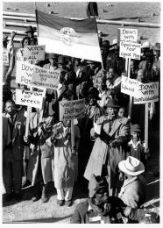
Congress of the People
Held in Kliptown (Near JHB) on 26 June 1955
3000 delegates from across South Africa Gathered
Mass democratic process
Started with a campaign asking ordinary people what kind of South Africa do you want
Adopted the Freedom Charter

Slide 31
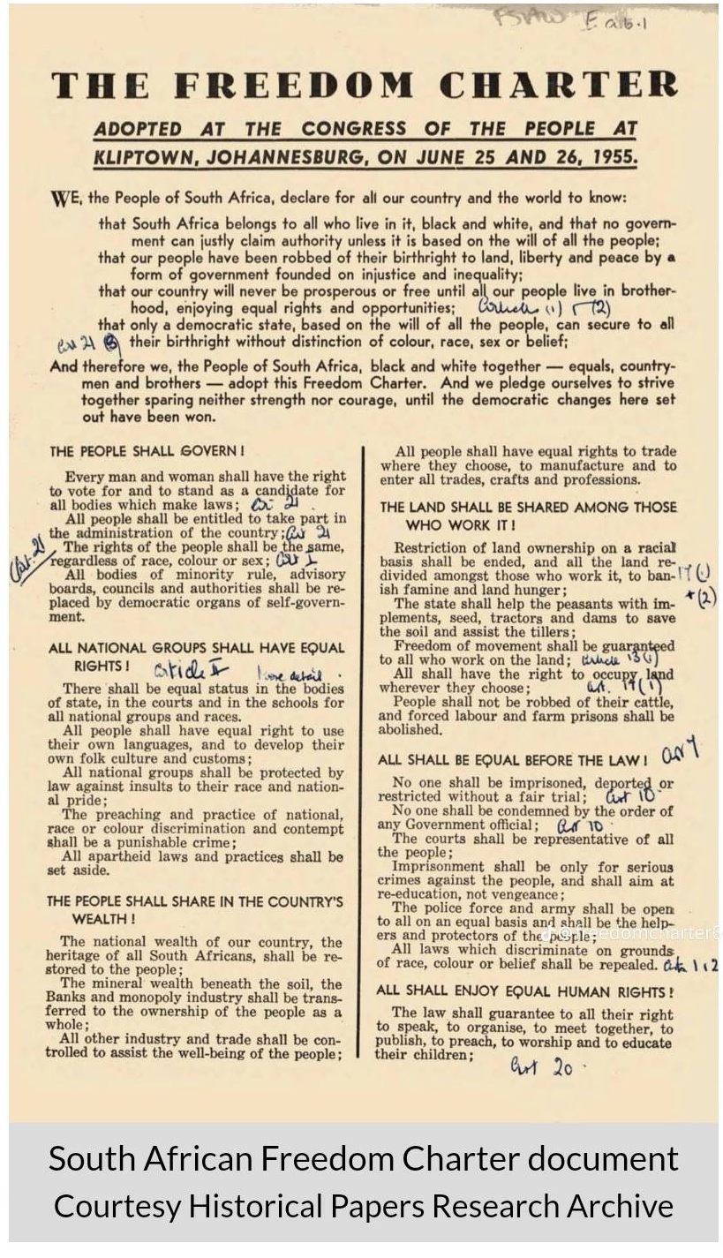
Freedom Chater
Declared “South Africa belongs to all who live in it”
Envisioned equality, shared citizenship, and socio-economic rights
Became the normative precursor to the 1996 Final Constitution
Notes:
https://sahistory.org.za/article/sharpeville-timeline
Consider content and consider to what extent the provisions of the Freedom Charter are contained in the current constitutional dispensation
Consider content and how it directly speaks to the context

Slide 32
Freedom Chater
Key Principles
Universal suffrage and democratic government
Equality before the law
Human rights and freedoms, including speech, assembly and movement
Redistribution of land and economic opportunity
Access to housing, education and work
Although not legally binding, Freedom Charter became a foundational ideological document for the liberation movement
Notes:
Consider the content and consider to what extent the provisions of the Freedom Charter are contained in the current constitutional dispensation
Consider content and how it directly speaks to the context

Slide 33
Road to Sharpeville (1959 – March 1960)
Anti-Pass campaign
6 Dec 1959 – ANC conference – Chief Albert Luthuli announces 1960 as the “ Year of the Pass”
16 March 1960 – Robert Sobukwe and the PAC announce that on 21 March 1960 there will be a mass pass law protest
PAC had recently split from the ANC

Slide 34
Road to Sharpeville (1959 – March 1960)
18 March 1960: PAC activists distribute circulars calling on black South Africans to:
Leave pass books at home
Voluntarily present themselves at police stations for arrest
The aim was to overwhelm the apartheid system and challenge pass laws directly

Slide 35
Sharpeville Massacre
21 March 1960: Thousands march peacefully to the Sharpeville police station without their passbooks
Police responded by opening fire on the crowed
69 people where killed
Hundreds injured
Witnesses later testified that police fired into an unarmed crowd, and later when and placed weapons in the hands of the dead

Slide 36
Sharpeville: Government Response
23 March 1960: Prime Minister Verwoed tells Parliament that the protests were not about pass laws and praisesd thr police response
23 March: Robert Sobukwe and PAC leaders are arrested
Protests spread across the country in response
24 March: gatherings of 12 or more people are banned and police surveillance increases

Slide 37
Sharpeville: Government Response
30 March 1960: Government declares a state of emergency
Used to suppress protests
Resulted in the mass detention of thousands of people
Resulted in the ANC and PAC being banned (Unlawful Organisations Act )
Lasted several months and marked a shift to the more violent, repressive phase of apartheid
Historical turning point and led to international criticism

Slide 38
1961 Constitution

Slide 39
1961 Constitution
5 October 1960: Referendum in which white-only voters approve the move to become a Republic, separate from Britain.
The British Monarch would be removed as head of state
South Africa wanted to be part of the Commonwealth but due to the recent political violence was not accepted by international community

Slide 40
1961 Constitution
32 May 1961 SA became a Republic and left the commonwealth
Retained the parliamentary system from the 1910 constitution
This constitution reinforced white minority dominance, and continued to exclude black South Africans from the political process
Notes:
Define Republic: A state in which supreme power is held by the people and their elected representatives, and which has an elected or nominated president rather than a monarch.

Slide 41
1961 Constitution
Most important change was that the Monarch would no longer be the head of state, this would not vest with the President, as elected by the people.
First president was C R Swart
Notes:
Define Republic: A state in which supreme power is held by the people and their elected representatives, and which has an elected or nominated president rather than a monarch.

Slide 42
Rivonia Trial
Suppression of political dissent
Suppression of Communism Act (1950),
Sabotage Act (1962),
Carried the death penalty
90-Day Detention Law (1963)
Allowed indefinite solitary confinement without charge, access to lawyers, or contact with family.
Notes:
Named after subburn where mostwhere arrested

Slide 43
Rivonia Trial
Held from 1963-1964
Landmark legal proceeding that resulted n life imprisonment of Nelson Mandela and other anti-apartheid leaders
Another historical turning point, which resulted in international scrutiny on apartheid regime
Notes:
Named after subburn where mostwhere arrested

Slide 44
Rivonia Trial
Trialists charged under laws specifically designed to criminalize resistance to racial oppression
Demonstrates how a legal system can be weaponised by those in power against the very people it should protect
Makes a case for why constitutions must entrench rights that constrain legislative power, not just procedural rules
Notes:
Named after subburn where mostwhere arrested

Slide 45
Rivonia Trial
Rather than mount a purely criminal defence, the accused chose to put apartheid itself on trial.
Mandela's famous "I am prepared to die" statement from the dock reframed the proceedings as a question of political legitimacy:
can a government that excludes the majority from political participation claim the right to prosecute them for defying its laws?
This connects directly to social contract theory and the question of what gives law its moral authority.
Notes:
Named after subburn where mostwhere arrested

Slide 46
Rivonia Trial
In short, the Rivonia Trial is a foundational case study in the difference between law and justice, the role of courts in authoritarian systems, why entrenched constitutional rights matter, and how the legacy of historical abuse shapes constitutional design.
It was a political win for the fight against apartheid, but with many of the leaders now in jail, the resistance saw setbacks and stagnation for several years following, in which time the oppression of the government continued and escalated .
Notes:
Named after subburn where mostwhere arrested

Slide 47
1983 Constitution

Slide 48
1983 Constitution
Republic of South Africa Constitution Act No 110 of 1983
Key legislative reform under Apartheid Regime – to entrench apartheid rule and response to internal protest and international pressure
Aimed to incorporate Coloured and Indian groups, to create a broader base of support for the white minority and fracture the non-racial dissent
Direct response to ever increasing urban protest and unrest, needed to ensure white control was maintained
Referendum November 2, 1983, with a 66.3% (whites only) yes vote for change

Slide 49
1983 Constitution
Created the Tricameral Parliament: Parliament was restructured into three separate houses
House of Assembly: For the white population group
House of Representatives: For the Coloured population group
House of Delegates: For the Indian population group
Total exclusion of Majority of Black African population – complete exclusion from any representation in the central government
Created a hierarchy among the non-white race groups (similar to the caste system in India?)

Slide 50
1983 Constitution
Competencies were categorised as “own” or “general” affairs
Own Affairs – handled by each separate house
General affairs – handled by full parliament
The Office of the Prime Minister was abolished
Symbolic State President replaced with executive State president, created consolidating power into an office not directly elected by the public but by the electoral college dominated by white ruling party
Executive authority rested with the cabinet

Slide 51
Next week ….
We will look closely at the 1980s ad 1990s !!
1980s State of emergency
1990s end of apartheid
First democratic elections
Interim Constitution
Final Constitution
Do the pre-readings please!

Slide 52
Early Responses
1955
1952
Drafting the Freedom Chater
1960
1963
Defiance Campaign
Sharpeville
Revionia trail
ANCemployed passive resistance tacitcs to resist newly imposed legal restrictions
Neptune is the fourth-largest planet in the Solar System
The Charter conhtained claims and expressed the asspirations of large sections of South African Citizenry who where oppressed by the reigime
Massicure where 68 where killed, inlcudiny 8 women and 10 children
180 others wounded

Slide 53
Early Responses
ANC formed in 1912 – response to Unification

Slide 54
Soweto Uprising
Constitutional Crisis brought on by Harris, I, Harris II, and Collins cemented the principle of parliamentary supremacy
It also ramped up the use of law enforcement of persons of colour
The introduction of Petty Apartheid

Slide 55
Global Standing
Constitutional Vision is grounded in the present reality faced by many South African’s
Acknowledgement of Colonial and Apartheid Past, which created an unjust and unequal Society
Wealth, resources and status were based on Race, Gender and Class
The Constitution seeks to CHANGE this sort of Society

Slide 56
GENERAL BACKGROUND
Mercury
Earth
Mercury is the closest planet to the Sun and the smallest one in the Solar System—it’s only a bit larger than the Moon
Earth is the third planet from the Sun and the only one that harbors life in the Solar System. This is where we all live

Slide 57
CONTENTS OF THIS TEMPLATE
This is a slide structure based on a multi-purpose presentation
You can delete this slide when you’re done editing the presentation
Fonts | To view this template correctly in PowerPoint, download and install the fonts we used
Used and alternative resources | An assortment of graphic resources that are suitable for use in this presentation
Thanks slide | You must keep it so that proper credits for our design are given
Colors | All the colors used in this presentation
Infographic resources | These can be used in the template, and their size and color can be edited
Customizable icons | They are sorted by theme so you can use them in all kinds of presentations
For more info: SLIDESGO | SLIDESGO SCHOOL | FAQS
You can visit our sister projects: FREEPIK | FLATICON | STORYSET | WEPIK | VIDFY

Slide 58
TABLE OF CONTENTS
01
02
03
04
Historical day
Significance
You can describe the topic of the section here
You can describe the topic of the section here
Analysis
Conclusions
You can describe the topic of the section here
You can describe the topic of the section here

Slide 59
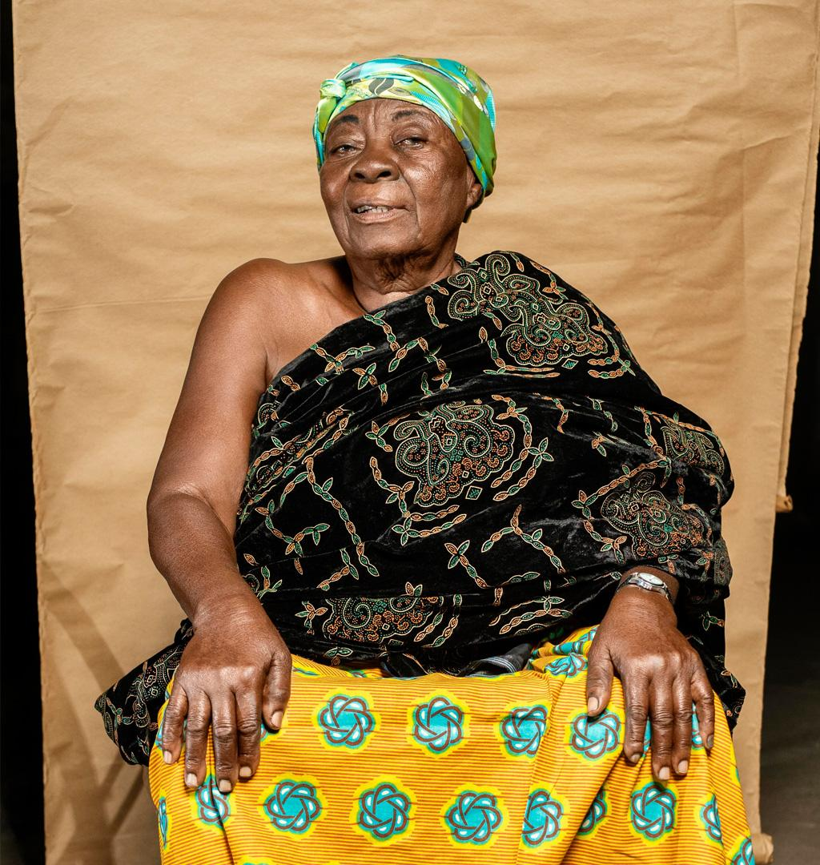

01
HISTORICAL DAY
You can enter a subtitle here if you need it

Slide 60
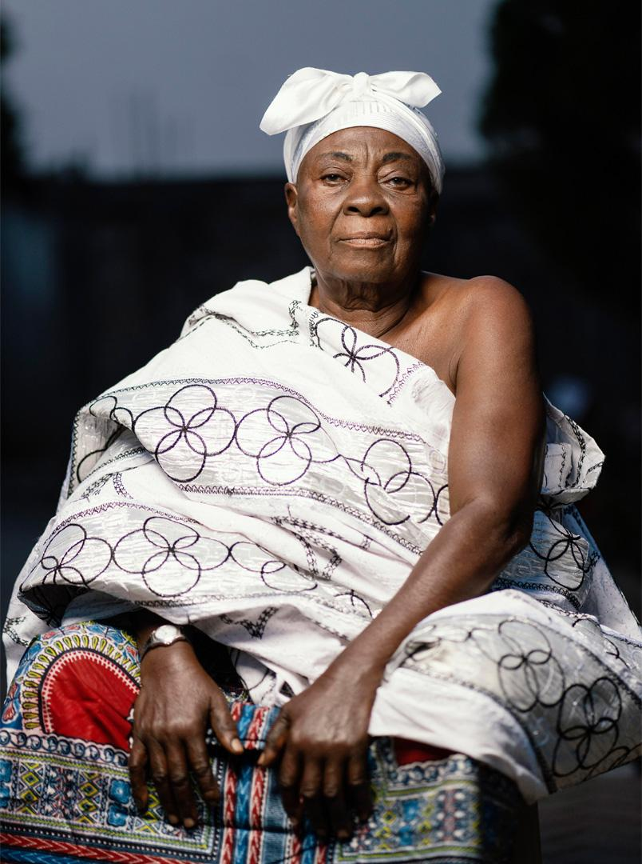
NATIONAL WOMEN’S DAY
Do you know what helps you make your point clear?
Lists like this one:
They’re simple
You can organize your ideas clearly
You’ll never forget to buy milk!
And the most important thing: the audience won’t miss the point of your presentation

Slide 61
PURPOSE OF CELEBRATING THE DAY
Mars
Mercury
Venus
Despite being red, Mars is actually a cold place. It’s full of iron oxide dust
Mercury is the closest planet to the Sun and the smallest in the System
Venus has a beautiful name and is the second planet from the Sun

Slide 62
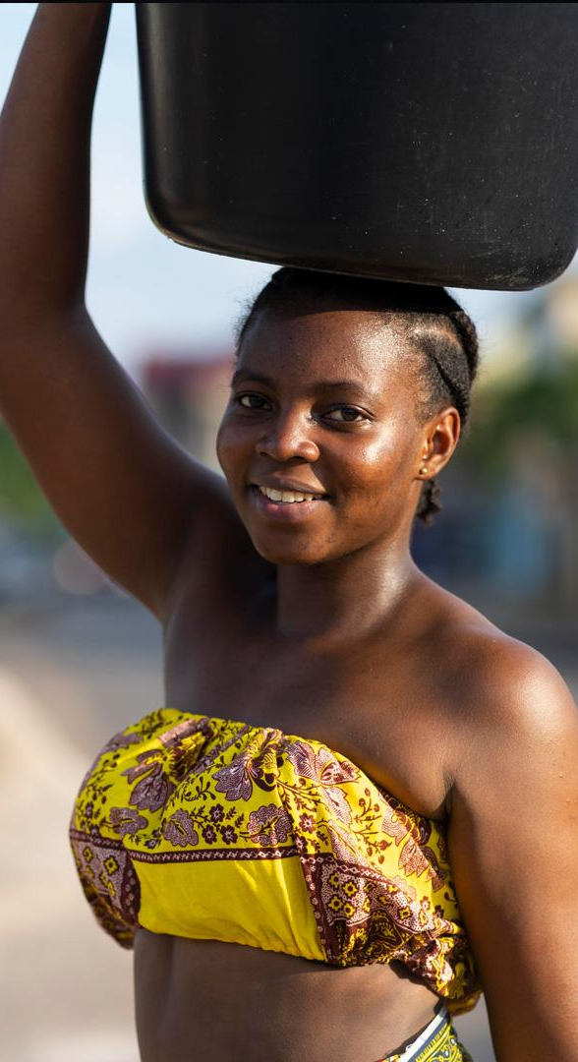

02
SIGNIFICANCE
You can enter a subtitle here if you need it

Slide 63
HOW WAS THIS DAY CREATED?
Jupiter
Jupiter is a gas giant and the biggest planet in the Solar System
Neptune
Neptune is also the fourth largest object by diameter in the Solar System

Slide 64
TO REMEMBER
Mercury
Mars
Mercury is the closest planet to the Sun and the smallest of them all
Mars is full of iron oxide dust, which gives the planet its reddish cast
Earth
Jupiter
Earth is the third planet from the Sun and the only one that harbors life
Jupiter was named after the Roman god of the skies and lightning

Slide 65
A PICTURE IS WORTH A THOUSAND WORDS

Slide 66
NATIONAL WOMEN’S DAY FACTS
Jupiter
Mercury
Saturn
Jupiter is the biggest planet of them all
Mercury is the closest planet to the Sun
Saturn is composed of hydrogen and helium
Venus
Neptune
Mars
Venus is the second planet from the Sun
Neptune is the farthest planet from the Sun
Despite being red, Mars is a very cold place

Slide 67
KEY DATES
1956
2006
1995
2022
Mercury
Saturn
Mercury is the closest planet to the Sun and the smallest one
Earth
Saturn is the second largest planet in the Solar System
Neptune
Earth is the only planet that harbors life of them all
Neptune is the fourth-largest planet in the Solar System

Slide 68
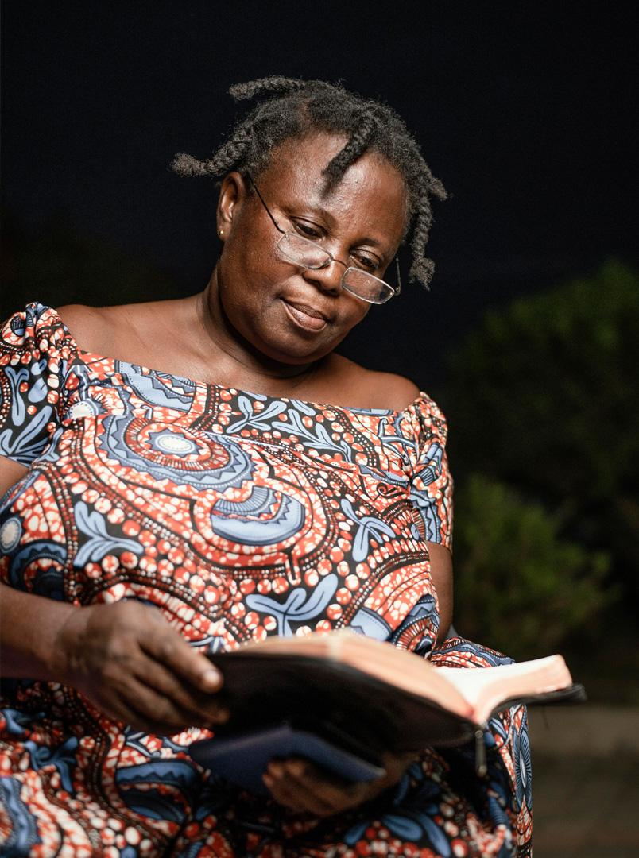
—Someone Famous
“This is a quote, words full of wisdom that someone important said and can make the reader get inspired.”

Slide 69
DID YOU KNOW THIS?
43%
57%
31%
74%
Mercury
Earth
Mars
Jupiter
Mercury is the closest planet to the Sun
Earth is the third planet from the Sun
Despite being red, Mars is very cold
Jupiter is the biggest planet of them all

Slide 70
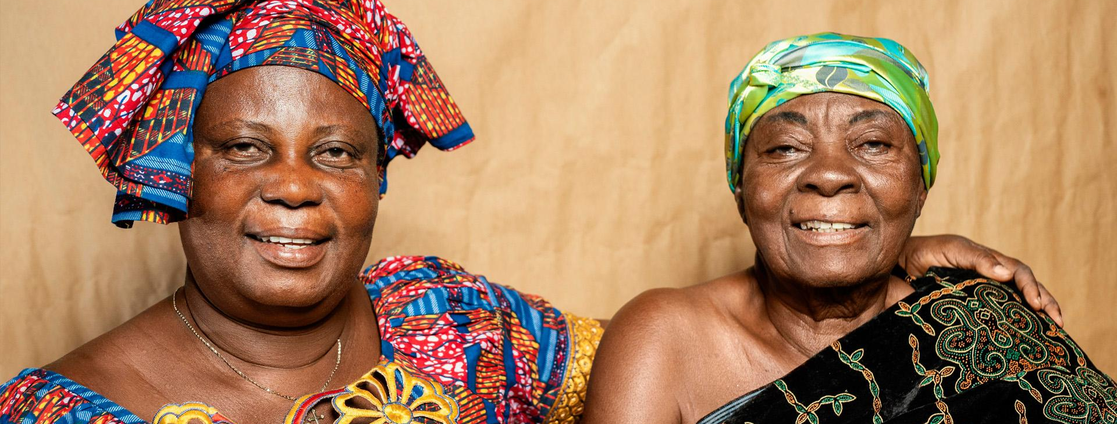
AWESOME WORDS

Slide 71
GETTING TO KNOW SOUTH AFRICA
South Africa
Despite being red, Mars is actually a cold place. It's full of iron oxide dust, which gives the planet its reddish cast

Slide 72
HOW TO CELEBRATE THIS DAY?
Activity 1
Neptune is the fourth-largest planet of them all
9th August
Activity 2
Jupiter is the biggest planet in the System
Activity 3
Despite being red, Mars is actually a cold place

Slide 73
1956
8 Aug
20,000
Mercury is the closest planet to the Sun
Saturn was named after a Roman god
Jupiter is a gas giant and the biggest planet

Slide 74
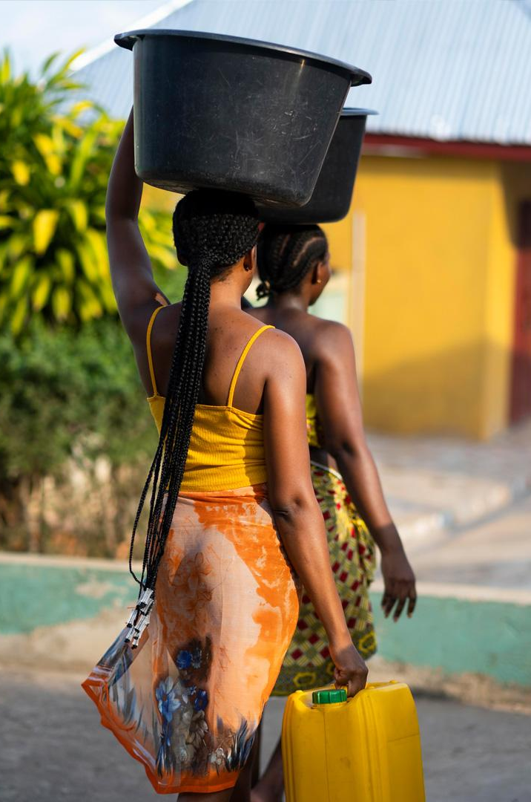
TO REINFORCE THE CONCEPT, TRY USING AN IMAGE
Images reveal large amounts of data, so remember: use an image instead of a long text. Your audience will appreciate it

Slide 75
DAY ACTIVITIES SCHEDULE
 | Morning |  | Evening
08:30h | Saturn has several rings and is composed of hydrogen and helium | 13:30h | Despite being red, Mars is actually a very cold place
11:00h | Neptune is the fourth-largest planet in the Solar System | 16:00h | Earth is the third planet from the Sun and the only one with life
12:00h | Jupiter is a gas giant and the biggest planet in the Solar System | 18:00h | Venus has a beautiful name, but also high temperatures

Slide 76
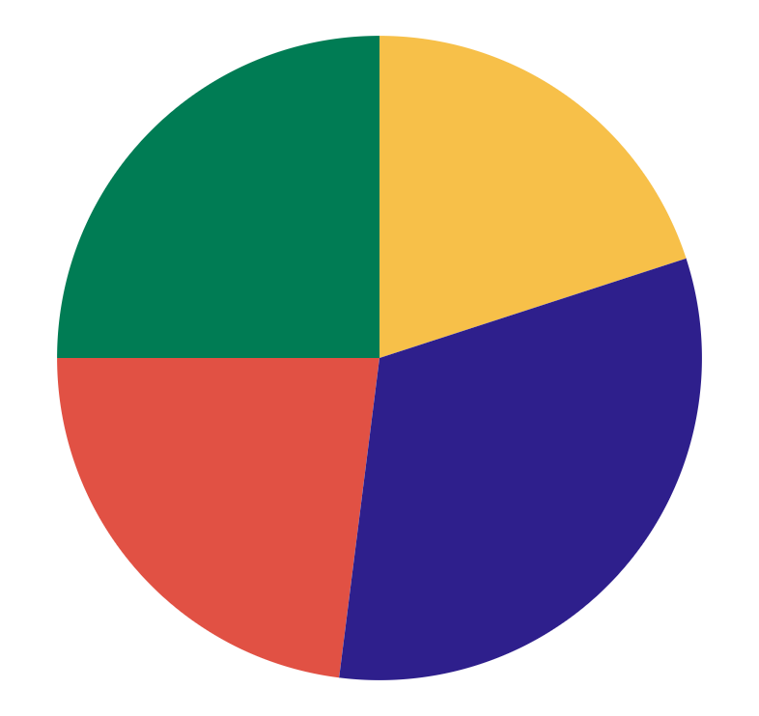
MAIN EVENTS
25%
20%
Jupiter
Neptune
Jupiter is the biggest planet in the Solar System
Neptune is the farthest planet from the Sun
23%
32%
Mars
Saturn
Despite being red, Mars is actually a cold place
Saturn is a gas giant and has several rings
Follow the link in the graph to modify its data and then paste the new one here. For more info, click here

Slide 77
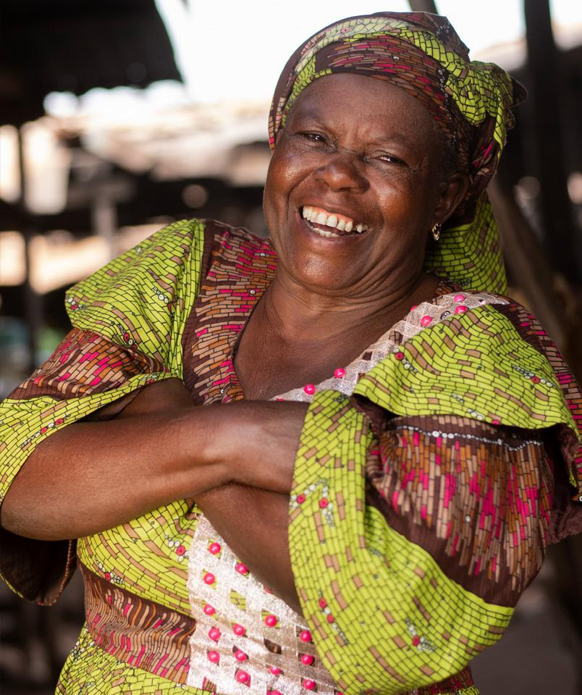
SELECTED REVIEWS
Tim Patterson
Anna Pitt
“Venus has a beautiful name and is the second planet from the Sun”
“Earth is the third planet from the Sun and the only one that harbors life”
Sarah Smith
Timmy Jimmy
“Mars is full of iron oxide dust, which gives the planet its reddish cast”
“Mercury is the closest planet to the Sun and the smallest of them all”

Slide 78
POWERFUL DAY FOR EQUAL RIGHTS
Mars
Despite being red, Mars is a cold place
Saturn
Earth
Saturn is not the only planet with rings
Earth is the planet where we all live
Jupiter
Jupiter was named after a Roman god

Slide 79
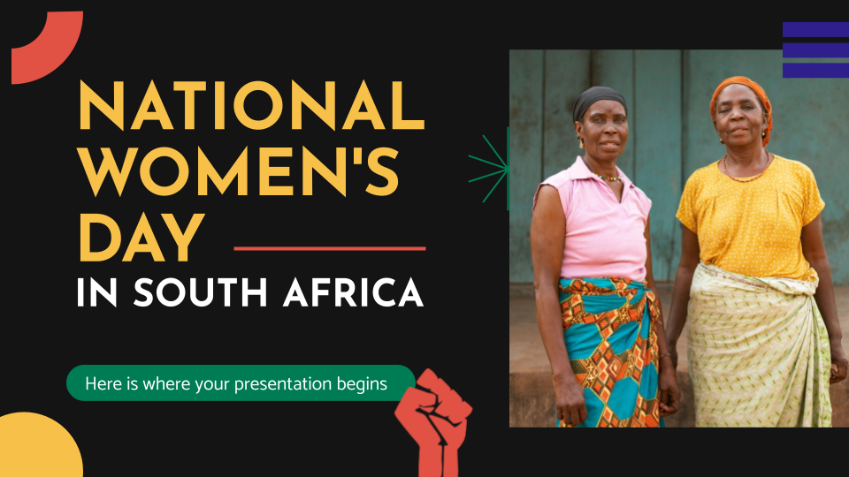
SUMMARY OF PREVIOUS YEARS
You can replace the image on the screen with your multimedia content. Just right-click on it and select “Replace image”

Slide 80
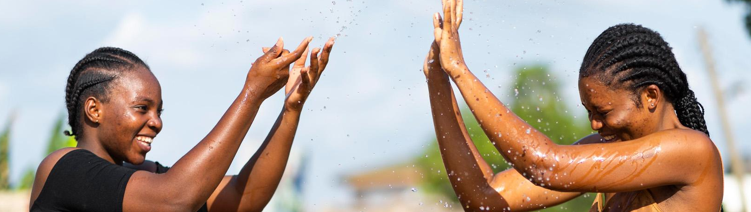

941,785
Big numbers catch your audience’s attention

Slide 81
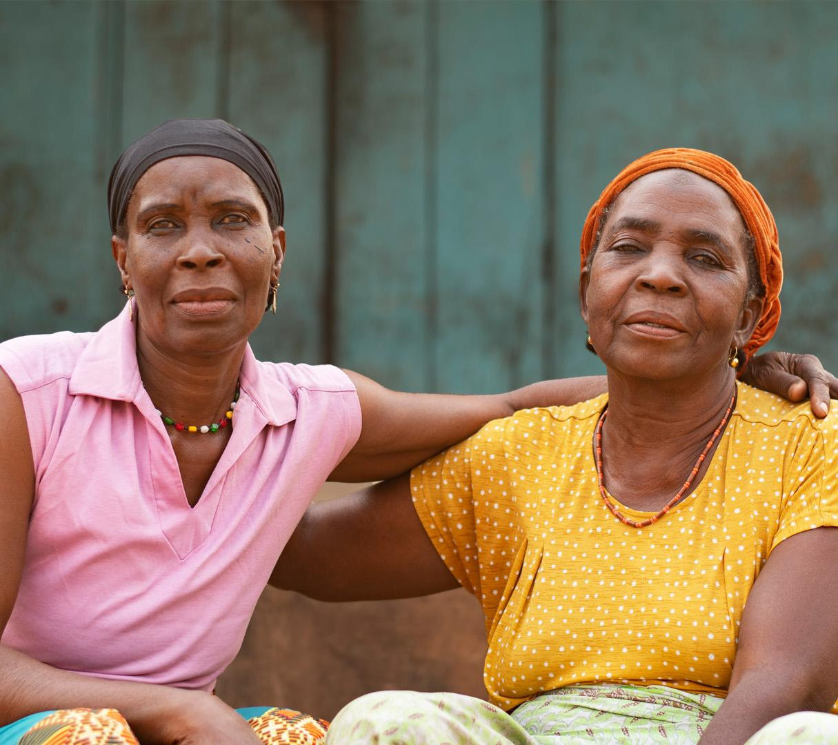
OUR TEAM
Susan Bones
You can speak a bit about this person here
Jenna Doe
You can speak a bit about this person here

Slide 82
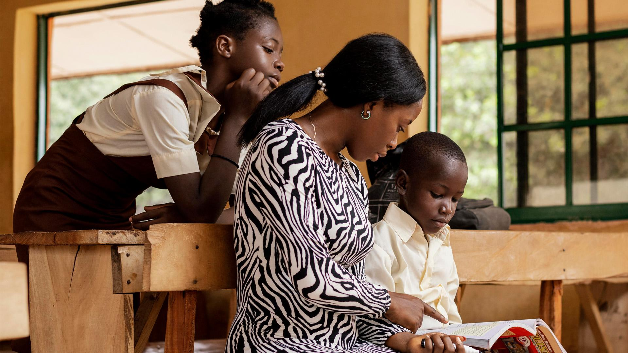

MAIN CONCLUSIONS
01
02
03
Mars
Mars full of iron oxide dust, which gives the planet its reddish cast
Venus
Venus has a beautiful name and is the second planet from the Sun
Mercury
Mercury is the closest planet to the Sun and the smallest of them all

Slide 83

MORE INFO ON THE WEBSITE
You can replace the image on the screen with your own work. Just right-click on it and select “Replace image”

Slide 84
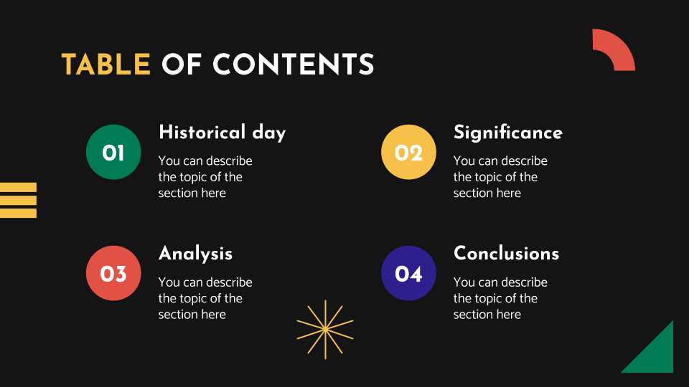
ACCESS WITH YOUR TABLET
You can replace the image on the screen with your own work. Just right-click on it and select “Replace image”

Slide 85
ALWAYS INFORMED OF YOUR NEEDS
You can replace the image on the screen with your own work. Just right-click on it and select “Replace image”

Slide 86
RELATED BOOKS YOU SHOULD READ
 |  |  | Status
Author (Year) | Title of the book | Publisher
Author (Year) | Title of the book | Publisher
Author (Year) | Title of the book | Publisher
Author (Year) | Title of the book | Publisher
Author (Year) | Title of the book | Publisher

Slide 87
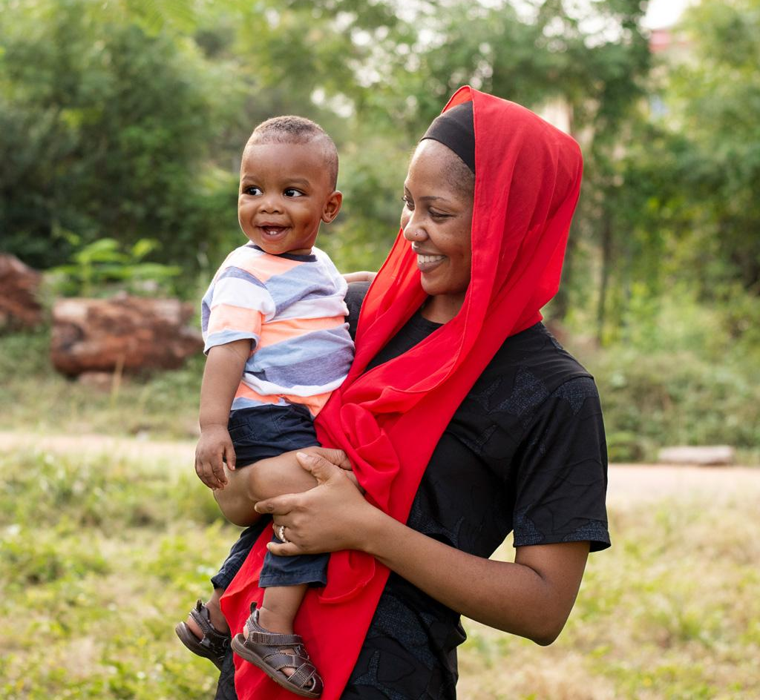
THANKS!
Do you have any questions?
youremail@freepik.com
+91 620 421 838
yourwebsite.com
Please keep this slide for attribution

Slide 88
ICON PACK

Slide 89
ALTERNATIVE RESOURCES
Here’s an assortment of alternative resources whose style fits the one of this template:
Photos
Medium shot african woman holding plant
Smiley woman exterior portrait
Full shot old woman exterior portrait
African senior woman portrait
African senior woman portrait I
Woman spending time with her black boy
Medium shot elderly woman outdoors
Medium shot old woman sitting outdoors
Senior african woman outdoors
Medium shot african woman outdoors
Medium shot old woman outdoors
Full shot african woman sitting on chair
Woman teaching kids in class
Beautiful african women fetching water
Beautiful african women having fun while fetching water

Slide 90
RESOURCES
Did you like the resources on this template? Get them for free at our other websites:
Photos
Smiley women exterior portrait
African senior woman
African senior woman I
African senior woman portrait
African senior woman portrait I
African senior woman portrait II
Beautiful african women fetching water
Beautiful african women fetching water I
Medium shot african women sitting together
Beautiful african women having fun while fetching water
Medium shot elderly african woman
Medium shot smiley elderly woman I
African woman teaching kids in class
Woman spending time with her black boy
Vectors
Juneteenth poster template design
Icons
Civil rights movements | Filled

Slide 91
Instructions for use
If you have a free account, in order to use this template, you must credit Slidesgo by keeping the Thanks slide. Please refer to the next slide to read the instructions for premium users.
As a Free user, you are allowed to:
- Modify this template.
- Use it for both personal and commercial projects.
You are not allowed to:
- Sublicense, sell or rent any of Slidesgo Content (or a modified version of Slidesgo Content).
- Distribute Slidesgo Content unless it has been expressly authorized by Slidesgo.
- Include Slidesgo Content in an online or offline database or file.
- Offer Slidesgo templates (or modified versions of Slidesgo templates) for download.
- Acquire the copyright of Slidesgo Content.
For more information about editing slides, please read our FAQs or visit Slidesgo School:
https://slidesgo.com/faqs and https://slidesgo.com/slidesgo-school

Slide 92
Instructions for use (premium users)
As a Premium user, you can use this template without attributing Slidesgo or keeping the "Thanks" slide.
You are allowed to:
Modify this template.
Use it for both personal and commercial purposes.
Hide or delete the “Thanks” slide and the mention to Slidesgo in the credits.
Share this template in an editable format with people who are not part of your team.
You are not allowed to:
Sublicense, sell or rent this Slidesgo Template (or a modified version of this Slidesgo Template).
Distribute this Slidesgo Template (or a modified version of this Slidesgo Template) or include it in a database or in any other product or service that offers downloadable images, icons or presentations that may be subject to distribution or resale.
Use any of the elements that are part of this Slidesgo Template in an isolated and separated way from this Template.
Register any of the elements that are part of this template as a trademark or logo, or register it as a work in an intellectual property registry or similar.
For more information about editing slides, please read our FAQs or visit Slidesgo School:
https://slidesgo.com/faqs and https://slidesgo.com/slidesgo-school

Slide 93
Fonts & colors used
This presentation has been made using the following fonts:
Josefin Sans
(https://fonts.google.com/specimen/Josefin+Sans)
Catamaran
(https://fonts.google.com/specimen/Catamaran)
#141414
#ffffff
#2e1f8c
#007c54
#e15144
#f7c049

Slide 94





Storyset
Create your Story with our illustrated concepts. Choose the style you like the most, edit its colors, pick the background and layers you want to show and bring them to life with the animator panel! It will boost your presentation. Check out how it works.
Pana
Amico
Bro
Rafiki
Cuate

Slide 95
Use our editable graphic resources...
You can easily resize these resources without losing quality. To change the color, just ungroup the resource and click on the object you want to change. Then, click on the paint bucket and select the color you want. Group the resource again when you’re done. You can also look for more infographics on Slidesgo.

Slide 98
JANUARY
FEBRUARY
MARCH
APRIL
MAY
JUNE
PHASE 1
Task 1
Task 2
PHASE 2
Task 1
Task 2
JANUARY
FEBRUARY
MARCH
APRIL
PHASE 1
Task 1
Task 2

Slide 101
...and our sets of editable icons
You can resize these icons without losing quality.
You can change the stroke and fill color; just select the icon and click on the paint bucket/pen.
In Google Slides, you can also use Flaticon’s extension, allowing you to customize and add even more icons.

Slide 102
Educational Icons
Medical Icons

Slide 103
Business Icons
Teamwork Icons

Slide 104
Help & Support Icons
Avatar Icons

Slide 105
Creative Process Icons
Performing Arts Icons

Slide 106
Nature Icons

Slide 107
SEO & Marketing Icons

Slide 108


